Slide 1
Optimal algorithms for experts and mixtures of Gaussians
Version of August 6, 2020
Chris Liaw
UBC, August 2020
Notes:
Slide numbers..

Slide 2
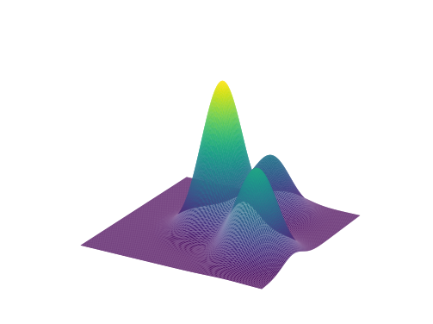
Research overview
Goal: Design & analyze machine learning algorithms with provable guarantees.
Prediction with expert advice
[HLPR, FOCS‘20]
Learning mixtures of Gaussians
[ABHLMP NeurIPS’18, JACM’20]

Slide 3
Part 1. Optimal anytime regret with two experts.
Nicholas J. A. Harvey, Christopher Liaw, Edwin Perkins, Sikander Randhawa. Optimal Anytime Regret with Two Experts. FOCS 2020.

Slide 4
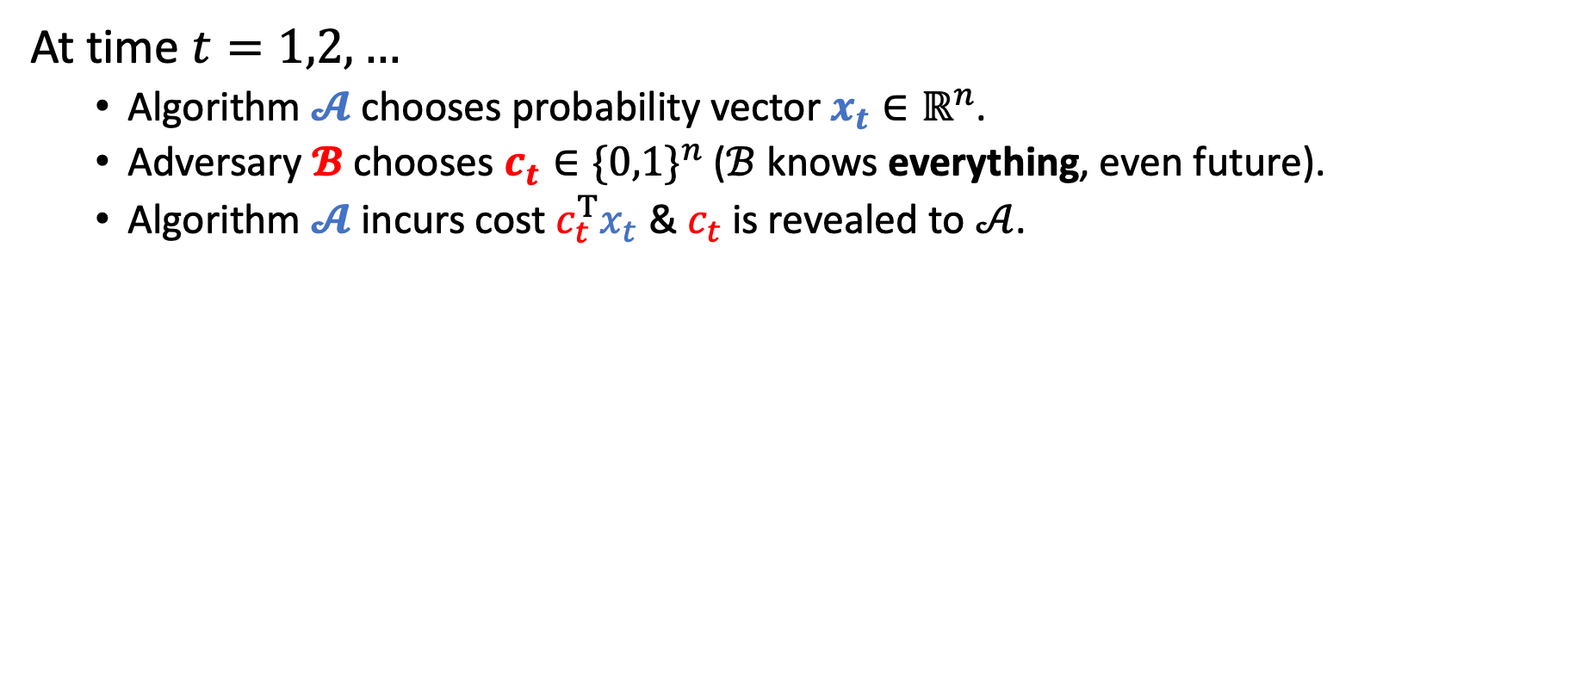
Prediction with expert advice
At time $t=1,2,…$
Algorithm $𝓐$ chooses probability vector $x_{t}∈ℝ^{n}$.
Adversary $𝓑$ chooses $c_{t}∈{\{0,1\}}^{n}$ ($ℬ$ knows everything, even future).
Algorithm $𝓐$ incurs cost $c_{t}^{T}x_{t}$ & $c_{t}$ is revealed to $𝒜$.

Slide 5
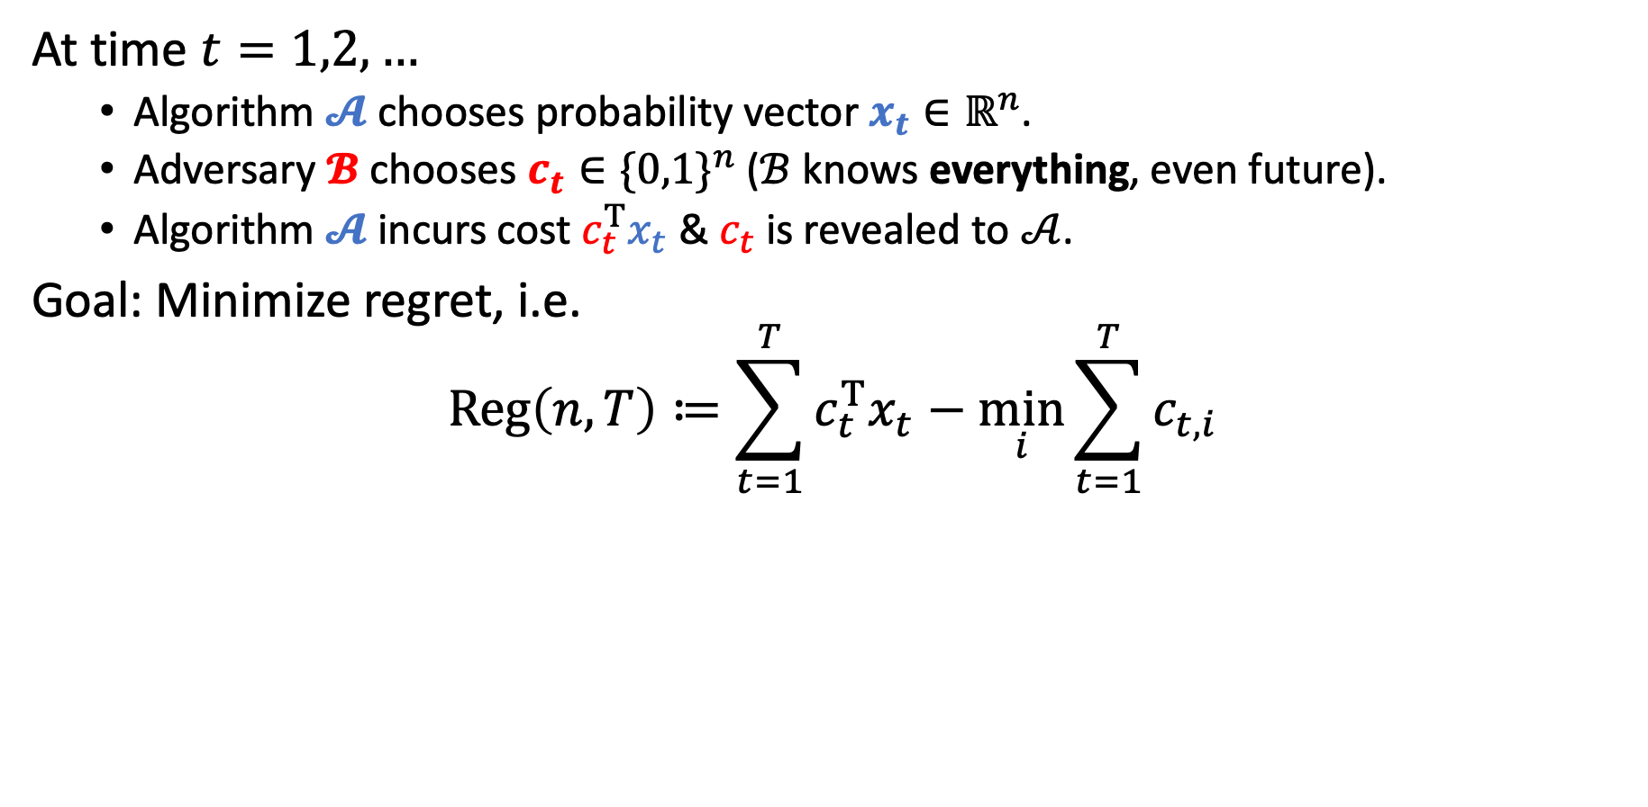
Prediction with expert advice
At time $t=1,2,…$
Algorithm $𝓐$ chooses probability vector $x_{t}∈ℝ^{n}$.
Adversary $𝓑$ chooses $c_{t}∈{\{0,1\}}^{n}$ ($ℬ$ knows everything, even future).
Algorithm $𝓐$ incurs cost $c_{t}^{T}x_{t}$ & $c_{t}$ is revealed to $𝒜$.
Goal: Minimize regret, i.e.
$$Reg\left(n,T\right)≔\sum_{t=1}^{T}{c_{t}^{T}x_{t}}−\min_{i}{\sum_{t=1}^{T}{c_{t,i}}}$$
Algorithm’s cost
Cost of best expert
Note. There is no randomness in the problem.

Slide 6
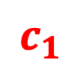
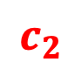
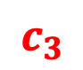
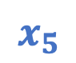
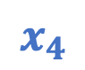



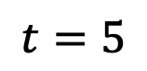
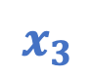
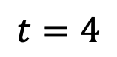
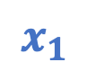
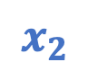
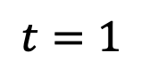
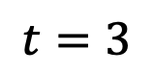
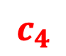
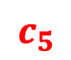
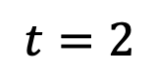

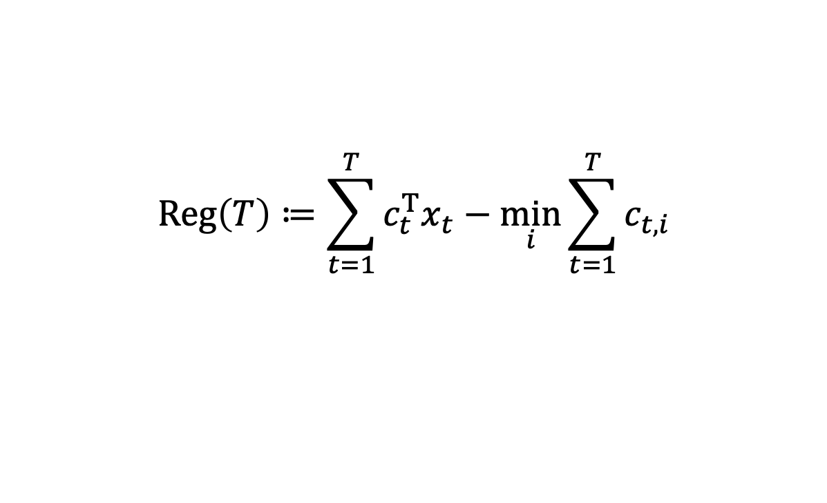



Example
$$Reg\left(T\right)≔\sum_{t=1}^{T}{c_{t}^{T}x_{t}}−\min_{i}{\sum_{t=1}^{T}{c_{t,i}}}$$
Follow best expert?
$$t=1$$
$$t=2$$
$$t=3$$
$$t=4$$
$$t=5$$
$$x_{1}$$
$$c_{1}$$
$$x_{2}$$
$$c_{2}$$
$$x_{3}$$
$$c_{3}$$
$$x_{4}$$
$$c_{4}$$
$$x_{5}$$
$$c_{5}$$
0.5
$$1$$
0.0
$$0$$
0.5
$$0$$
1.0
$$1$$
0.5
$$1$$
0.5
$$0$$
1.0
$$1$$
0.5
$$1$$
0.0
$$0$$
0.5
$$0$$
Algorithm
0.5
1.5
2
3
3.5
Best Expert
0
1
1
2
2
Regret
0.5
0.5
1.0
1.0
1.5

Slide 7
Example
$$Reg\left(T\right)≔\sum_{t=1}^{T}{c_{t}^{T}x_{t}}−\min_{i}{\sum_{t=1}^{T}{c_{t,i}}}$$
Follow best expert?
$$t=1$$
$$t=2$$
$$t=3$$
$$t=4$$
$$t=5$$
$$x_{1}$$
$$c_{1}$$
$$x_{2}$$
$$c_{2}$$
$$x_{3}$$
$$c_{3}$$
$$x_{4}$$
$$c_{4}$$
$$x_{5}$$
$$c_{5}$$
0.5
$$1$$
0.0
$$0$$
0.5
$$0$$
1.0
$$1$$
0.5
$$1$$
0.5
$$0$$
1.0
$$1$$
0.5
$$1$$
0.0
$$0$$
0.5
$$0$$
Following best expert can make regret grow linearly.
Algorithm
0.5
1.5
2
3
3.5
Best Expert
0
1
1
2
2
Regret
0.5
0.5
1.0
1.0
1.5

Slide 8
Example
$$Reg\left(T\right)≔\sum_{t=1}^{T}{c_{t}^{T}x_{t}}−\min_{i}{\sum_{t=1}^{T}{c_{t,i}}}$$
A little hedging…
$$t=1$$
$$t=2$$
$$t=3$$
$$t=4$$
$$t=5$$
$$x_{1}$$
$$c_{1}$$
$$x_{2}$$
$$c_{2}$$
$$x_{3}$$
$$c_{3}$$
$$x_{4}$$
$$c_{4}$$
$$x_{5}$$
$$c_{5}$$
0.5
$$1$$
0.4
$$0$$
0.5
$$0$$
0.6
$$1$$
0.5
$$1$$
0.5
$$0$$
0.6
$$1$$
0.5
$$1$$
0.4
$$0$$
0.5
$$0$$
Algorithm
0.5
1.1
1.6
2.2
2.7
Best Expert
0
1
1
2
2
Regret
0.5
0.1
0.6
0.2
0.7

Slide 9
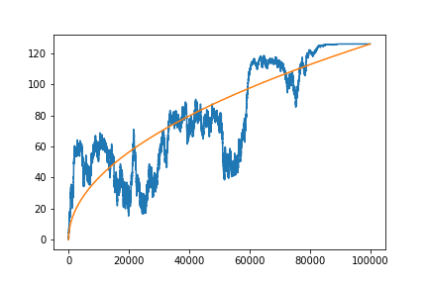
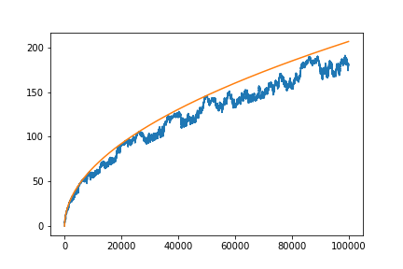

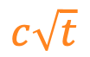

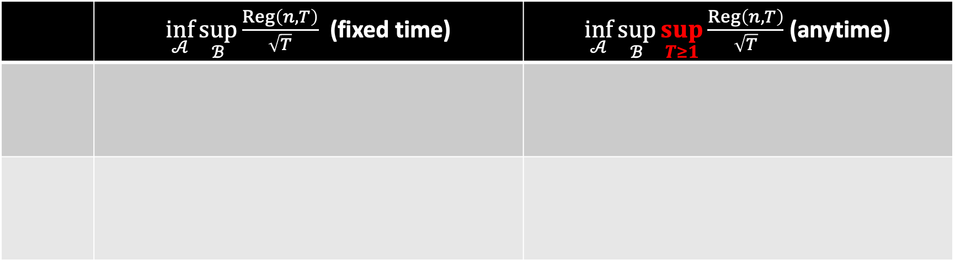

Known results
 | $\inf_{𝒜}{\sup_{ℬ}{\frac{Reg\left(n,T\right)}{\sqrt{T}}}}$ (fixed time) | $\inf_{𝒜}{\sup_{ℬ}{\sup_{T≥1}{\frac{Reg\left(n,T\right)}{\sqrt{T}}}}}$ (anytime)
$$c\sqrt{t}$$
$$c\sqrt{t}$$
$$Reg\left(t\right)$$
$$Reg\left(t\right)$$

Slide 10
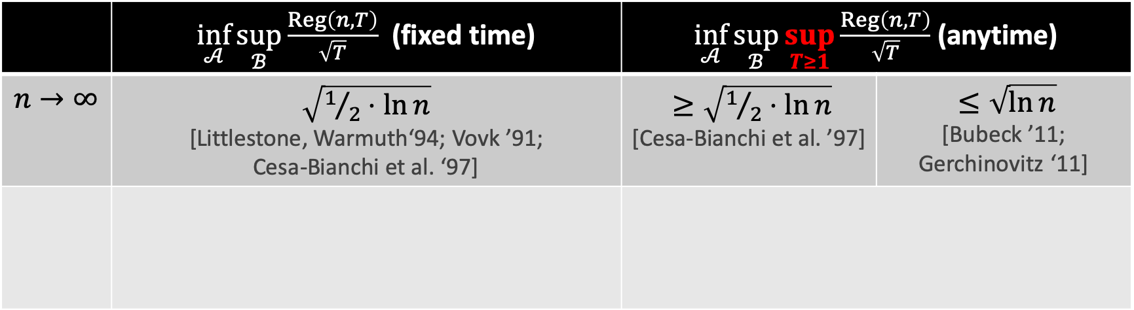
Known results
 | $\inf_{𝒜}{\sup_{ℬ}{\frac{Reg\left(n,T\right)}{\sqrt{T}}}}$ (fixed time) | $\inf_{𝒜}{\sup_{ℬ}{\sup_{T≥1}{\frac{Reg\left(n,T\right)}{\sqrt{T}}}}}$ (anytime)
$$n→∞$$ | $\sqrt{1/2⋅ln{n}}$ [Littlestone, Warmuth‘94; Vovk ’91; Cesa-Bianchi et al. ‘97] | $≥\sqrt{1/2⋅\ln{n}}$ [Cesa-Bianchi et al. ’97] | $≤\sqrt{\ln{n}}$ [Bubeck ’11; Gerchinovitz ‘11]
$$c\sqrt{t}$$
$$c\sqrt{t}$$
$$Reg\left(t\right)$$
$$Reg\left(t\right)$$

Slide 11
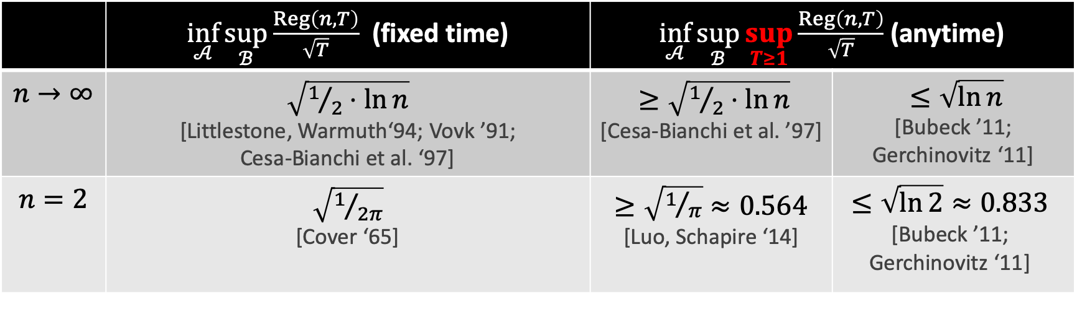
Known results
 | $\inf_{𝒜}{\sup_{ℬ}{\frac{Reg\left(n,T\right)}{\sqrt{T}}}}$ (fixed time) | $\inf_{𝒜}{\sup_{ℬ}{\sup_{T≥1}{\frac{Reg\left(n,T\right)}{\sqrt{T}}}}}$ (anytime)
$$n→∞$$ | $\sqrt{1/2⋅ln{n}}$ [Littlestone, Warmuth‘94; Vovk ’91; Cesa-Bianchi et al. ‘97] | $≥\sqrt{1/2⋅\ln{n}}$ [Cesa-Bianchi et al. ’97] | $≤\sqrt{\ln{n}}$ [Bubeck ’11; Gerchinovitz ‘11]
$$n=2$$ | $\sqrt{1/{2π}}$ [Cover ‘65] | $≥\sqrt{1/π}≈0.564$ [Luo, Schapire ‘14] | $$≤\sqrt{\ln{2}}≈0.833$$ [Bubeck ’11; Gerchinovitz ‘11]
$$c\sqrt{t}$$
$$c\sqrt{t}$$
$$Reg\left(t\right)$$
$$Reg\left(t\right)$$

Slide 12
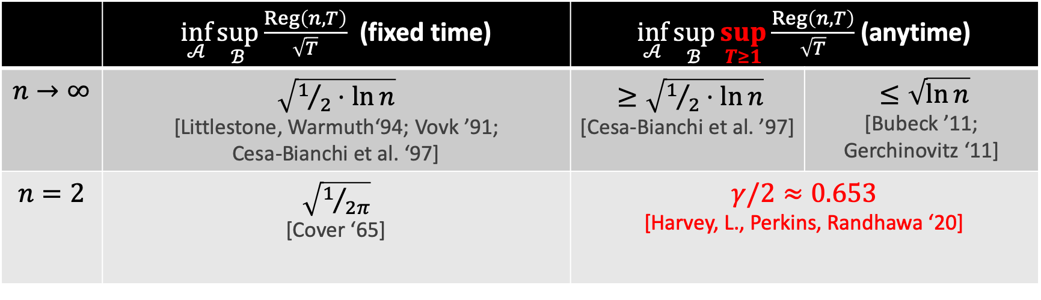
Known results
 | $\inf_{𝒜}{\sup_{ℬ}{\frac{Reg\left(n,T\right)}{\sqrt{T}}}}$ (fixed time) | $\inf_{𝒜}{\sup_{ℬ}{\sup_{T≥1}{\frac{Reg\left(n,T\right)}{\sqrt{T}}}}}$ (anytime)
$$n→∞$$ | $\sqrt{1/2⋅ln{n}}$ [Littlestone, Warmuth‘94; Vovk ’91; Cesa-Bianchi et al. ‘97] | $≥\sqrt{1/2⋅\ln{n}}$ [Cesa-Bianchi et al. ’97] | $≤\sqrt{\ln{n}}$ [Bubeck ’11; Gerchinovitz ‘11]
$$n=2$$ | $\sqrt{1/{2π}}$ [Cover ‘65] | $γ/2≈0.653$ [Harvey, L., Perkins, Randhawa ‘20]
$$c\sqrt{t}$$
$$c\sqrt{t}$$
$$Reg\left(t\right)$$
$$Reg\left(t\right)$$

Slide 13
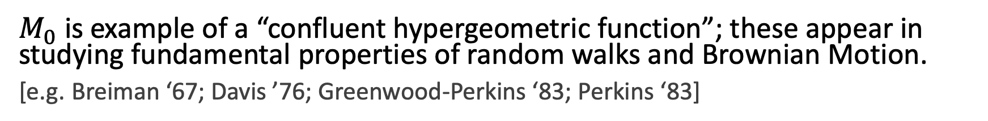
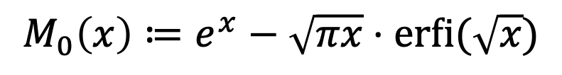
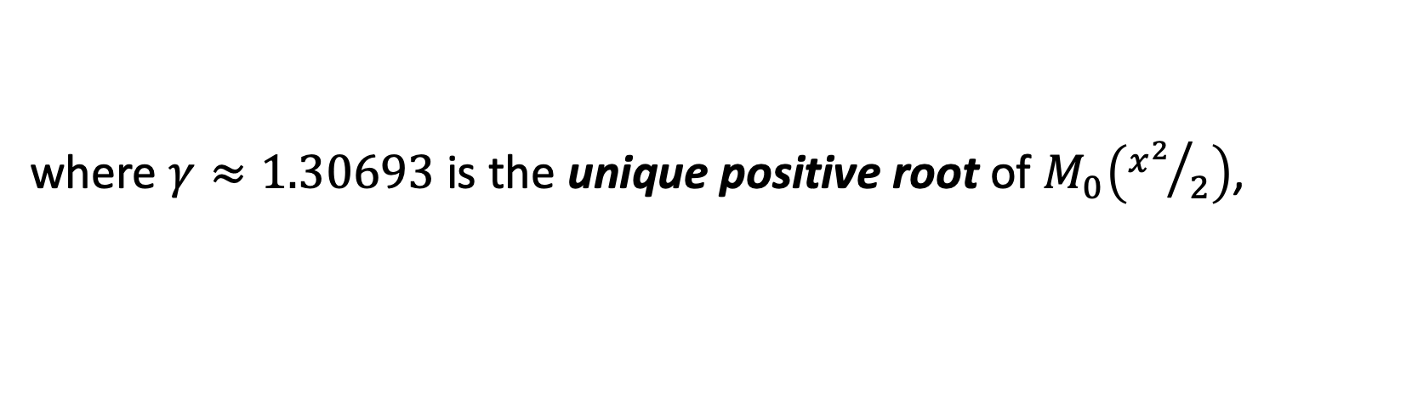
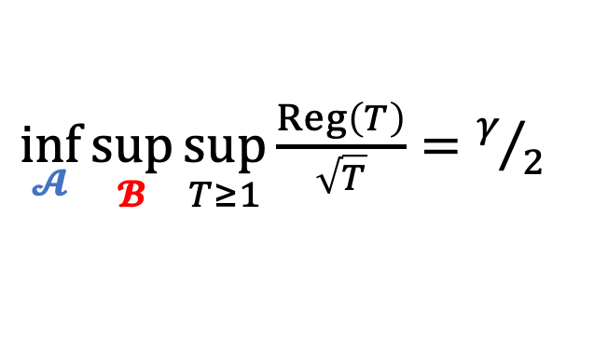
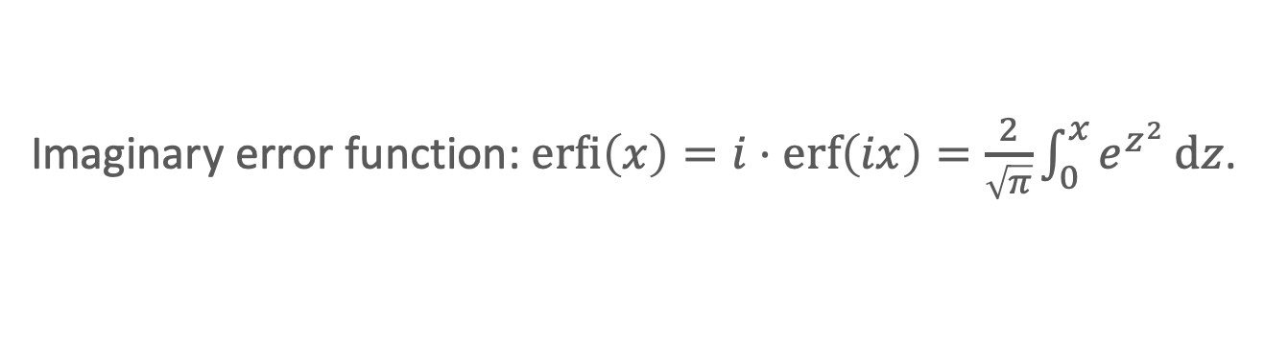
Our result
Imaginary error function: $\operatorname{erfi}\left(x\right)=i⋅erf\left(ix\right)=\frac{2}{\sqrt{π}}\int_{0}^{x}{e^{z^{2}}}dz$.
Theorem [HLPR ‘20]
For $n=2$ experts:
$\inf_{𝓐}{\sup_{𝓑}{\sup_{T≥1}{\frac{Reg\left(T\right)}{\sqrt{T}}}}}=γ/2$
where $γ≈1.30693$ is the unique positive root of $M_{0}\left({x^{2}}/2\right)$,
$$M_{0}\left(x\right)≔e^{x}−\sqrt{πx}⋅\operatorname{erfi}{(\sqrt{x}})$$
$M_{0}$ is example of a “confluent hypergeometric function”; these appear in studying fundamental properties of random walks and Brownian Motion.
[e.g. Breiman ‘67; Davis ’76; Greenwood-Perkins ‘83; Perkins ‘83]
Today: we focus on the algorithm; its design involves stochastic calculus, PDEs, & confluent hypergeometric functions.

Slide 14
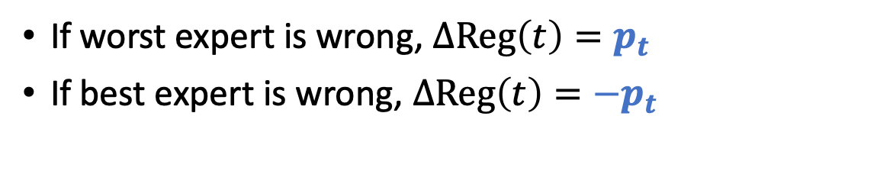
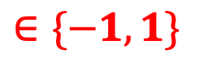
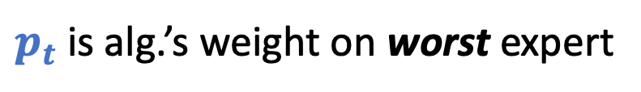
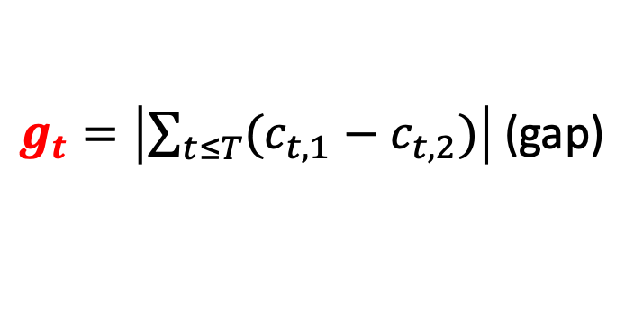
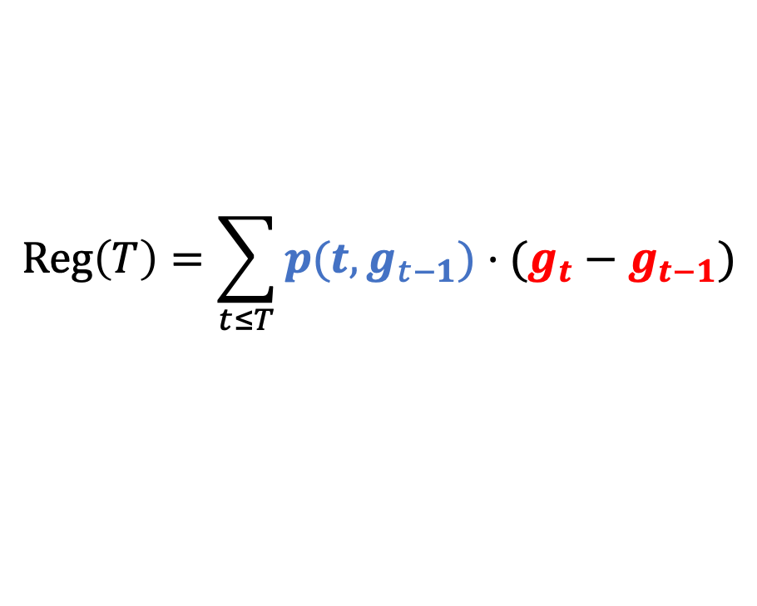
Regret as a stochastic integral
Discrete regret for two experts.
$$Reg\left(T\right)=\sum_{t≤T}{p(t,g_{t−1})⋅(g_{t}−g_{t−1})}$$
$g_{t}=\left|\sum_{t≤T}{(c_{t,1}−c_{t,2})}\right|$ (gap)
$$∈\{−1,1\}$$
$p_{t}$ is alg.’s weight on worst expert
If worst expert is wrong, $ΔReg\left(t\right)=p_{t}$
If best expert is wrong, $ΔReg\left(t\right)={−p}_{t}$

Slide 15

Regret as a stochastic integral
Discrete regret for two experts.
$$Reg\left(T\right)=\sum_{t≤T}{p(t,g_{t−1})⋅(g_{t}−g_{t−1})}$$
$g_{t}=\left|\sum_{t≤T}{(c_{t,1}−c_{t,2})}\right|$ (gap)
$$∈\{−1,1\}$$
$p_{t}$ is alg.’s weight on worst expert
Idea. View $g_{t}$ as reflected random walk. Goal. Control $Reg\left(T\right)$ a.s.
Alg/Adv play at discrete times.

Slide 16
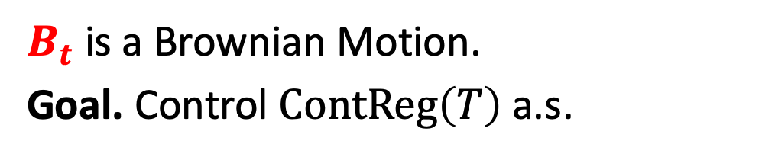
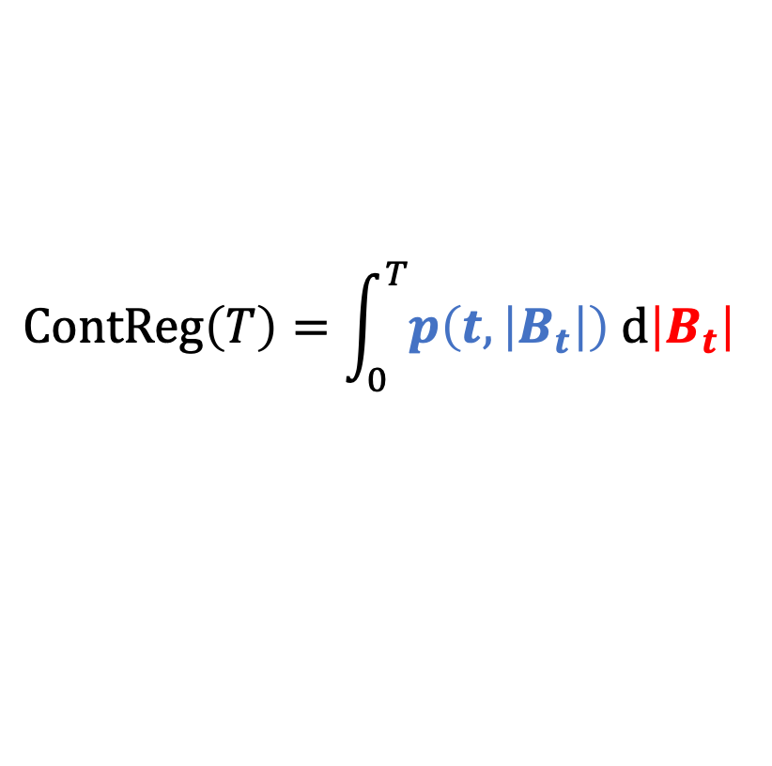
Regret as a stochastic integral
Discrete regret for two experts.
Continuous regret for two experts.
$$Reg\left(T\right)=\sum_{t≤T}{p(t,g_{t−1})⋅(g_{t}−g_{t−1})}$$
$$ContReg\left(T\right)=\int_{0}^{T}{p\left(t,\left|B_{t}\right|\right) d\left|B_{t}\right| }$$
Idea. View $g_{t}$ as reflected random walk. Goal. Control $Reg\left(T\right)$ a.s.
$B_{t}$ is a Brownian Motion.
Goal. Control $ContReg\left(T\right)$ a.s.
Alg/Adv play at discrete times.
Alg/Adv play continuously.

Slide 17
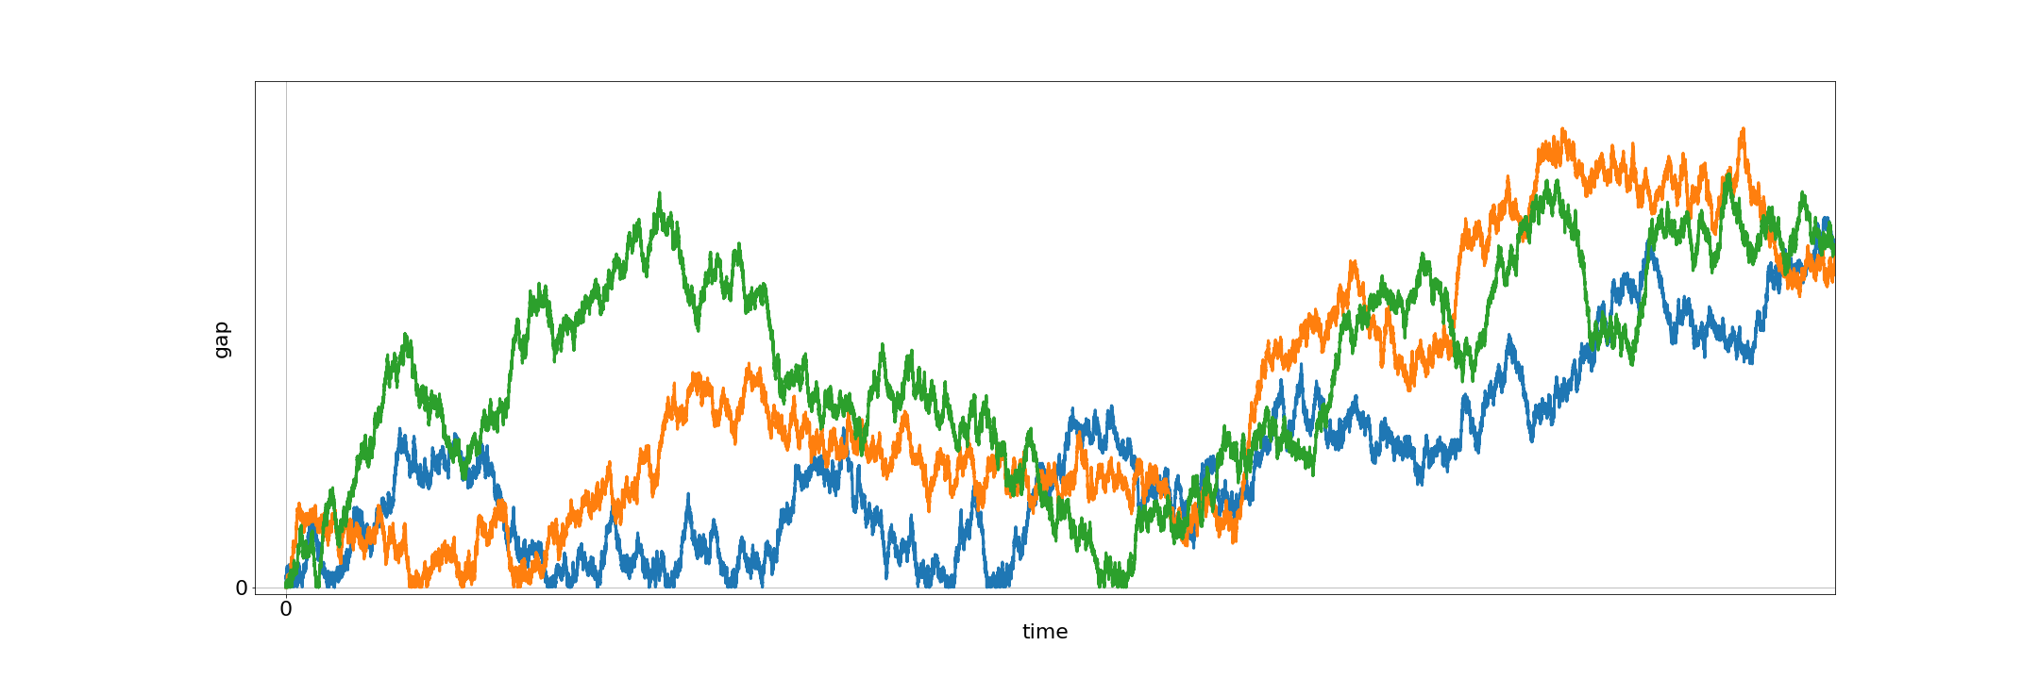
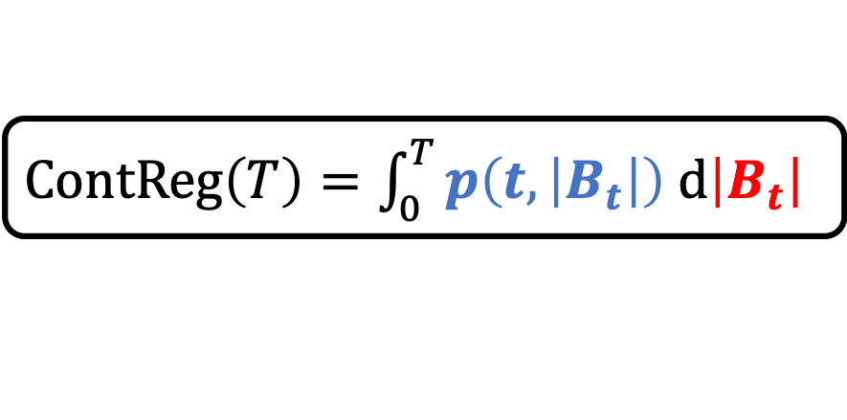
Designing the algorithm
$ContReg\left(T\right)=\int_{0}^{T}{p\left(t,\left|B_{t}\right|\right) d\left|B_{t}\right| }$
Kiyoshi Itô
Key Idea. Design $p$ so that all paths have equal regret.
$$ContReg\left(T\right)≠ContReg\left(T\right)≠ContReg(T)$$

Slide 18
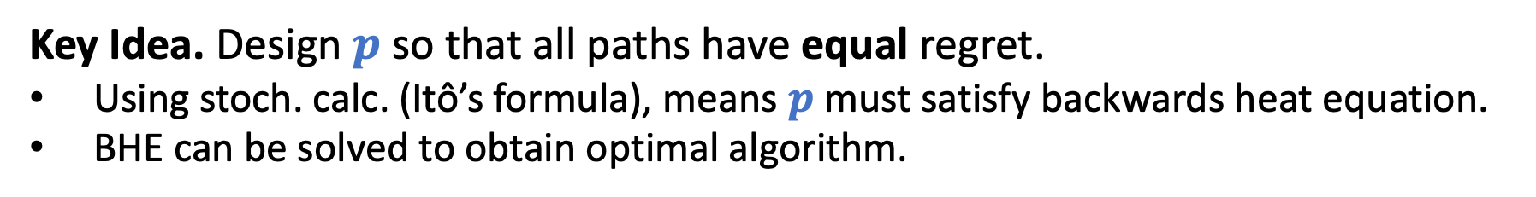
Designing the algorithm
$ContReg\left(T\right)=\int_{0}^{T}{p\left(t,\left|B_{t}\right|\right) d\left|B_{t}\right| }$
Kiyoshi Itô
Key Idea. Design $p$ so that all paths have equal regret.
Using stoch. calc. (Itô’s formula), means $p$ must satisfy backwards heat equation.
BHE can be solved to obtain optimal algorithm.
Miracle. Arguments can be discretized with no loss.
$$ContReg\left(T\right)=ContReg\left(T\right)=ContReg(T)$$

Slide 19
Part 2. Sample-optimal algorithms for learning mixtures of Gaussians.
Hassan Ashtiani, Shai Ben-David, Nicholas J. A. Harvey, Christopher Liaw, Abbas Mehrabian, Yaniv Plan. Near-optimal Sample Complexity Bounds for Robust Learning of Gaussian Mixtures via Compression Schemes. Journal of the ACM. 2020.

Slide 20

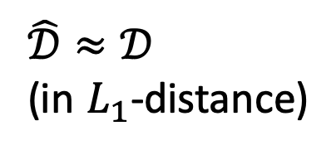

Density estimation
Unknown Distribution $𝒟$
i.i.d. samples
$$\hat{𝒟}≈𝒟$$
(in $L_{1}$-distance)

Slide 21
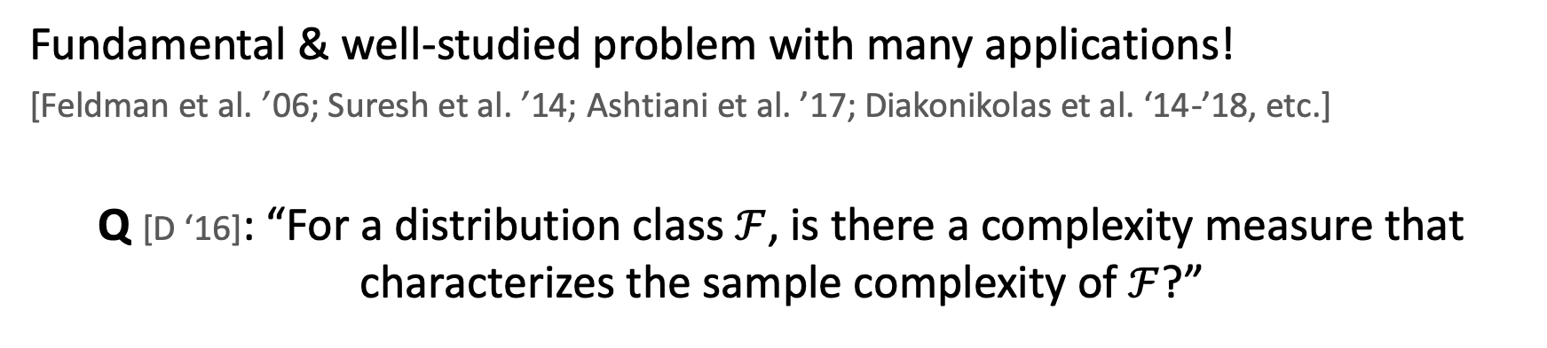
Density estimation
Unknown Distribution $𝒟$
i.i.d. samples
$$\hat{𝒟}≈𝒟$$
(in $L_{1}$-distance)
Fundamental & well-studied problem with many applications!
[Feldman et al. ’06; Suresh et al. ’14; Ashtiani et al. ’17; Diakonikolas et al. ‘14-’18, etc.]
Q [D ‘16]: “For a distribution class $ℱ$, is there a complexity measure that characterizes the sample complexity of $ℱ$?”

Slide 22
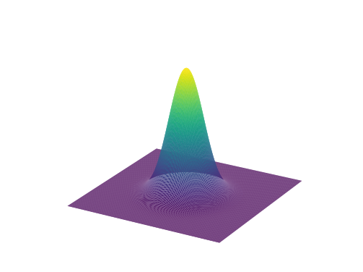
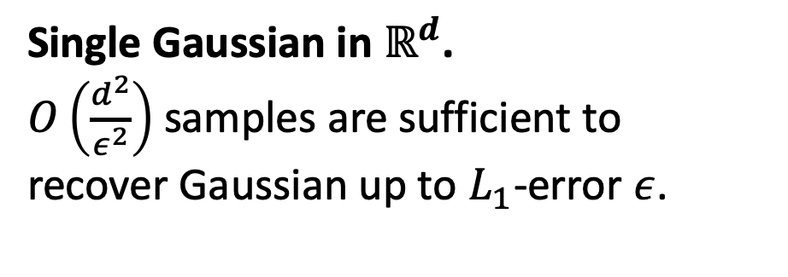
Learning Gaussians
Single Gaussian in $ℝ^{d}$.
$O\left(\frac{d^{2}}{ε^{2}}\right)$ samples are sufficient to
recover Gaussian up to $L_{1}$-error $ε$.

Slide 23
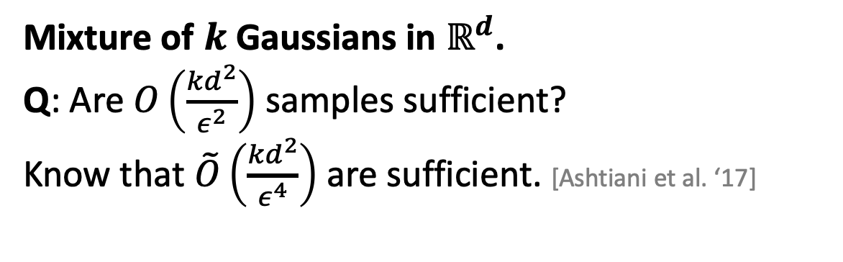
Learning Gaussians
Single Gaussian in $ℝ^{d}$.
$O\left(\frac{d^{2}}{ε^{2}}\right)$ samples are sufficient to
recover Gaussian up to $L_{1}$-error $ε$.
Mixture of $k$ Gaussians in $ℝ^{d}$.
Q: Are $O\left(\frac{{kd}^{2}}{ε^{2}}\right)$ samples sufficient?
Know that $\tilde{O}\left(\frac{{kd}^{2}}{ε^{4}}\right)$ are sufficient. [Ashtiani et al. ‘17]
Note: We aim to recover density, not parameters of the mixture.

Slide 24
Main contribution
“Other things being equal, simpler explanations are generally better…” [William of Ockham]
One manifestation of this in learning theory is “sample compression”.
[e.g. Littlestone, Warmuth ‘86; Moran, Yehudayoff ‘16]

Slide 25
Main contribution
“Other things being equal, simpler explanations are generally better…” [William of Ockham]
One manifestation of this in learning theory is “sample compression”.
[e.g. Littlestone, Warmuth ‘86; Moran, Yehudayoff ‘16]
We introduce a simple & sample-efficient technique for density estimation via compression schemes.

Slide 26
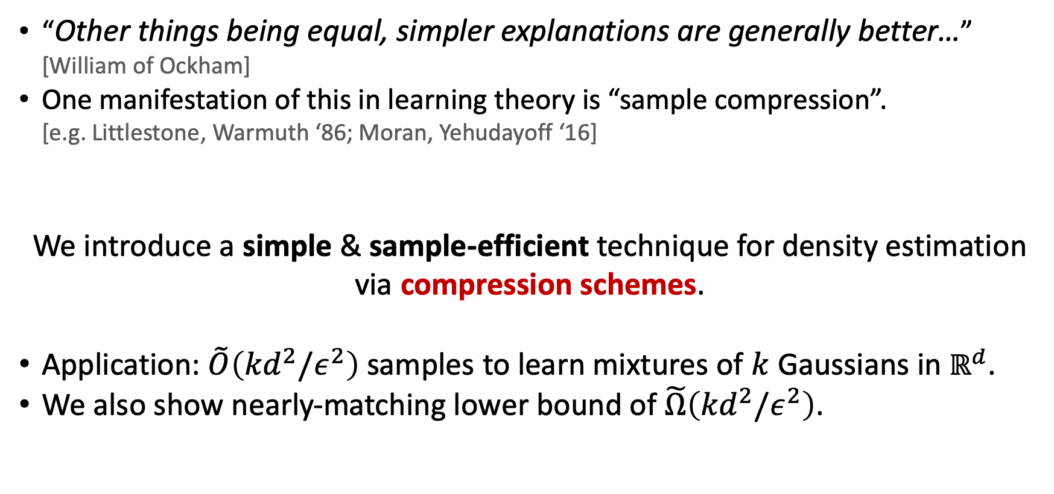

Main contribution
“Other things being equal, simpler explanations are generally better…” [William of Ockham]
One manifestation of this in learning theory is “sample compression”.
[e.g. Littlestone, Warmuth ‘86; Moran, Yehudayoff ‘16]
We introduce a simple & sample-efficient technique for density estimation via compression schemes.
Application: $\tilde{O}\left({kd}^{2}/ε^{2}\right)$ samples to learn mixtures of $k$ Gaussians in $ℝ^{d}$.
We also show nearly-matching lower bound of $\tilde{Ω}\left({kd}^{2}/ε^{2}\right)$.
*Note: $\tilde{O}$ and $\tilde{Ω}$ hide $polylog(kd/ε)$ factors.

Slide 27
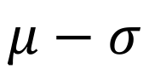
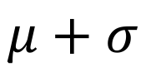
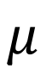

Compression Gaussians in $ℝ$
$$𝒩\left(μ, σ^{2}\right)$$
$$μ−σ$$
$$μ$$
$$μ+σ$$

Slide 28
Compression Gaussians in $ℝ$
$$𝒩\left(μ, σ^{2}\right)$$
$$μ−σ$$
$$μ$$
$$μ+σ$$

Slide 29





Compression Gaussians in $ℝ$
$$𝒩\left(μ, σ^{2}\right)$$
$$X_{1}$$
$$X_{2}$$
$$μ−σ$$
$$μ$$
$$μ+σ$$
$$\frac{X_{2}+X_{1}}{2}≈μ$$
$$\frac{X_{2}−X_{1}}{2}≈σ$$
Two samples are sufficient to encode $𝒩\left(μ, σ^{2}\right)$.

Slide 30






Compression framework
$ℱ$: a class of densities (e.g. Gaussians)
$m$ i.i.d. samples
from $f∈ℱ$
$t$ points
reconstruct
$$\hat{f}≈f$$
Knows $f$, $ℱ$
Knows $ℱ$
If Alice draws $m$ samples, sends $t$ points,
and $d_{TV}\left(f,\hat{f}\right)<ε$ then $ℱ$ admits $t$-compression.

Slide 31

Compression framework
$ℱ$: a class of densities (e.g. Gaussians)
$m$ i.i.d. samples
from $f∈ℱ$
$t$ points
reconstruct
$$\hat{f}≈f$$
Knows $f$, $ℱ$
Knows $ℱ$
If Alice draws $m$ samples, sends $t$ points,
and $d_{TV}\left(f,\hat{f}\right)<ε$ then $ℱ$ admits $t$-compression.

Slide 32


Compression Theorem
Theorem [ABHLMP ‘18]
If $ℱ$ has a compression scheme of size $t$ then sample complexity to learn $ℱ$ (up to $L_{1}$-error $ε$) is
$$\tilde{O}\left(\frac{t}{ε^{2}}\right).$$
$\tilde{O}\left(∙\right)$ hides polylog factors
Small compression schemes imply
sample-efficient algorithms.

Slide 33



Compression of mixtures
Cheat: assume a uniform mixture.
$$𝒩\left(μ_{3}, σ_{3}^{2}\right)$$
$$𝒩\left(μ_{1}, σ_{1}^{2}\right)$$
$$𝒩\left(μ_{2}, σ_{2}^{2}\right)$$

Slide 34
Compression of mixtures
Cheat: assume a uniform mixture.
$$𝒩\left(μ_{3}, σ_{3}^{2}\right)$$
$$𝒩\left(μ_{1}, σ_{1}^{2}\right)$$
$$𝒩\left(μ_{2}, σ_{2}^{2}\right)$$

Slide 35









Compression of mixtures
Cheat: assume a uniform mixture.
$$𝒩\left(μ_{3}, σ_{3}^{2}\right)$$
$$𝒩\left(μ_{1}, σ_{1}^{2}\right)$$
$$𝒩\left(μ_{2}, σ_{2}^{2}\right)$$
$$X_{1}$$
$$X_{2}$$
$$X_{3}$$
$$X_{4}$$
$$X_{5}$$
$$X_{6}$$
$$X_{1}≈μ_{1}−σ_{1}$$
$$X_{2}≈μ_{1}+σ_{1}$$
$$X_{3}≈μ_{2}−σ_{2}$$
$$X_{4}≈μ_{2}+σ_{2}$$
$$X_{5}≈μ_{3}−σ_{3}$$
$$X_{6}≈μ_{3}+σ_{3}$$

Slide 36

Compression of mixtures
Cheat: assume a uniform mixture.
$$𝒩\left(μ_{3}, σ_{3}^{2}\right)$$
$$𝒩\left(μ_{1}, σ_{1}^{2}\right)$$
$$𝒩\left(μ_{2}, σ_{2}^{2}\right)$$
$$X_{1}$$
$$X_{2}$$
$$X_{3}$$
$$X_{4}$$
$$X_{5}$$
$$X_{6}$$
If $ℱ$ has $t$-compression then
$k$ mixtures of $ℱ$ have $\sim kt\text{−}\text{compression}$.

Slide 37

Compression Theorem for mixtures
Theorem [ABHLMP ‘18]
If $ℱ$ has a compression scheme of size $t$ then sample complexity to learn $k$ mixtures of $ℱ$ (up to $L_{1}$-error $ε$) is
$$\tilde{O}\left(\frac{kt}{ε^{2}}\right).$$
$\tilde{O}\left(∙\right)$ hides polylog factors
Small compression schemes imply
sample-efficient algorithms for mixtures.

Slide 38






Compression scheme for Gaussians
$$X_{2}$$
To recover $𝒩\left(0, Σ\right)$, suffices to encode eigenvectors/eigenvalues of $Σ$.
Idea: Encode axes of ellipsoid using linear combination of samples.
Claim. Can encode an axis w/ $\sim d$ samples.
Total: $\sim d^{2}$ samples for all $d$ axes.
$$v_{1}$$
$$v_{2}$$
$$X_{1}$$
Ellipsoid defined by $Σ$.
Points drawn from $𝒩\left(0, Σ\right)$.

Slide 39



Application: Learning mixtures of Gaussians
Theorem [ABHLMP ‘18]
Sample complexity for learning mixtures of $k$ Gaussians in $ℝ^{d}$ up to $L_{1}$-error $ε$ is
$$\tilde{O}\left(\frac{kd^{2}}{ε^{2}}\right).$$
$\tilde{O}\left(∙\right)$ hides polylog factors
Improves upon:
$O(k^{4}d^{4}/ε^{2})$ via a VC-dimension argument
$\tilde{O}(kd^{2}/ε^{4})$ [Ashtiani, Ben-David, Mehrabian ‘17]
This is nearly-tight! We show $\tilde{Ω}\left(kd^{2}/ε^{2}\right)$ samples are necessary.
Improves on previous bound of $\tilde{Ω}\left(kd/ε^{2}\right)$[Suresh et al. NeurIPS ‘14]

Slide 40
Summary
Prediction with expert advice
Uses ideas from stochastic calculus & PDEs to design optimal algorithm for two experts.
Lower bound uses martingales, Davis’ inequality, optional stopping.
Learning mixtures of Gaussians
Illustrates compression framework to design sample-efficient algorithms for density estimation.
Upper and lower bound uses many ideas from high-dimensional probability (convex hulls of Gaussian vectors, concentration of singular values, etc.).

Slide 41

Future Work
Prediction with expert advice
Extend stochastic calculus ideas to other online learning problems.
Close the gap for $n$ experts.
Learning mixtures of Gaussians
Apply the compression technique to other natural distributions.
Faster algorithms for learning mixtures of Gaussians.

Slide 42


I am grateful to my committee...

Slide 43






& amazing co-authors, friends…
Notes:
Missing Taylor

Slide 44
Thank you!

